Slide 1
Lexical Semantics
Week 8, Lecture 1

Slide 2
Lexical Semantics
Definition
Lexical semantics is concerned with the systematic meaning related connections among lexical items, and the internal meaning-related structure of individual lexical items.
To identify the semantics of lexical items, we need to focus on the notion of
lexeme, an individual entry in the lexicon.
What is a lexeme?
Lexeme should be thought of as a pairing of a particular orthographic and phonological form with some sort of symbolic meaning representation.
Orthographic form, and phonological form refer to the appropriate form part of a lexeme
Sense refers to a lexeme’s meaning counterpart.
Week 8, Lecture 1
2 / 18

Slide 3
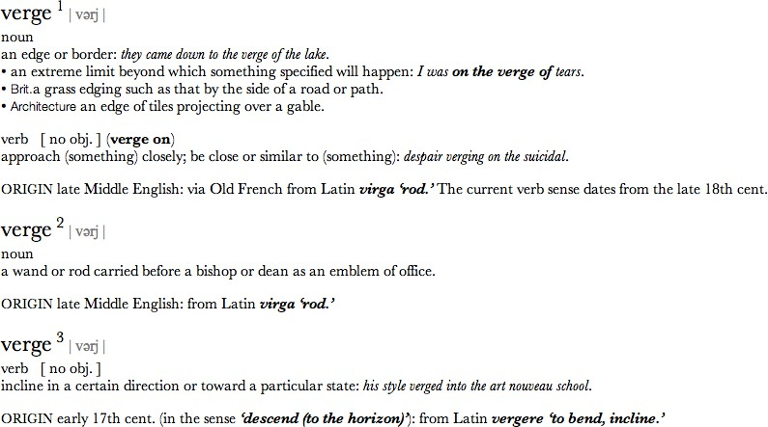
Example
Week 8, Lecture 1

Slide 4
Example: meaning related facts?
Definitions from the American Heritage Dictionary (Morris, 1985)
right adj. located near the right hand esp. being on the right when facing the same direction as the observer
left adj. located near to this side of the body than the right
red n. the color of blood or a ruby
blood n. the red liquid that circulates in the heart, arteries and veins of animals
The entries are description of lexemes in terms of other lexemes
Definitions make it clear that right and left are similar kind of lexemes that stand in some kind of alternation, or opposition, to one another
We can glean that red is a color, it can be applied to both blood and
rubies, and that blood is a liquid.
Week 8, Lecture 1
4 / 18

Slide 5
Relations between word meanings
Homonymy Polysemy Synonymy Antonymy Hypernymy Hyponymy Meronymy
Week 8, Lecture 1

Slide 6
Homonymy
Definition
Homonymy is defined as a relation that holds between words that have the same form with unrelated meanings.
Examples
Bat (wooden stick-like thing) vs Bat (flying mammal thing) Bank (financial institution) vs Bank (riverside)
homophones and homographs
homophones are the words with the same pronunciation but different spellings.
write vs right piece vs peace
homographs are the lexemes with the same orthographic form but different meaning. Ex: bass
Week 8, Lecture 1
6 / 18

Slide 7
Problems for NLP applications
Text-to-Speech
Same orthographic form but different phonological form
Information Retrieval
Different meaning but same orthographic form
Speech Recognition
to, two, too
Perfect homonyms are also problematic
Week 8, Lecture 1
7 / 18

Slide 8
Polysemy
Multiple related meanings within a single lexeme.
The bank was constructed in 1875 out of local red brick. I withdrew the money from the bank.
Are those the same sense?
Sense 1: “The building belonging to a financial institution”
Sense 2: “A financial institution”
Another example
Heavy snow caused the roof of the school to collapse. The school hired more teachers this year than ever before.
Week 8, Lecture 1
8 / 18

Slide 9
Polysemy: multiple related meanings
Often, the relationships are systematic
E.g., building vs. organization
school, university, hospital, church, supermarket
More examples:
Author (Jane Austen wrote Emma) ↔ Works of Author (I really love Jane Austen)
Animal (The chicken was domesticated in Asia) ↔ Meat (The chicken was overcooked)
Tree (Plums have beautiful blossoms) ↔ Fruit (I ate a preserved plum yesterday)
Week 8, Lecture 1
9 / 18

Slide 10
Polysemy: multiple related meanings
Zeugma test
Which of these flights serve breakfast? Does Midwest Express serve Philadelphia?
*Does Midwest Express serve breakfast and San Jose?
Combine two separate uses of a lexeme into a single example using conjunction
Since it sounds weird, we say that these are two different senses of serve.
Week 8, Lecture 1
10 / 18

Slide 11
Synonymy
Words that have the same meaning in some or all contexts.
filbert / hazelnut couch / sofa
big / large automobile / car vomit / throw up water / H₂O
Two lexemes are synonyms if they can be successfully substituted for each other in all situations.
Week 8, Lecture 1

Slide 12
Synonymy: A relation between senses
Consider the words big and large.
Are they synonyms?
How big is that plane?
Would I be flying on a large or small plane?
How about here?
Miss Nelson, for instance, became a kind of big sister to Benjamin.
*Miss Nelson, for instance, became a kind of large sister to Benjamin.
Why?
big has a sense that means being older, or grown up
large lacks this sense
Week 8, Lecture 1
12 / 18

Slide 13
Synonyms
Shades of meaning
What is the cheapest first class fare?
*What is the cheapest first class price?
Collocational constraints
We frustate ’em and frustate ’em, and pretty soon they make a big
mistake.
*We frustate ’em and frustate ’em, and pretty soon they make a large
mistake.
Week 8, Lecture 1
13 / 18

Slide 14
Antonyms
Senses that are opposites with respect to one feature of their meaning Otherwise, they are similar!
dark / light
short / long
hot / cold
up / down
in / out
More formally: antonyms can
define a binary opposition or at opposite ends of a scale (long/short,
fast/slow )
Be reversives: rise/fall
Week 8, Lecture 1
14 / 18

Slide 15
Hyponymy and Hypernymy
Hyponymy
One sense is a hyponym of another if the first sense is more specific, denoting a subclass of the other
car is a hyponym of vehicle dog is a hyponym of animal mango is a hyponym of fruit
Hypernymy
Conversely
vehicle is a hypernym/superordinate of car animal is a hypernym of dog
fruit is a hypernym of mango
Week 8, Lecture 1
15 / 18

Slide 16
Hyponymy more formally
Entailment
Sense A is a hyponym of sense B if being an A entails being a B. Ex: dog, animal
Transitivity
A hypo B and B hypo C entails A hypo C
Week 8, Lecture 1

Slide 17
Meronyms and holonyms
Definition
Meronymy: an asymmetric, transitive relation between senses.
X is a meronym of Y if it denotes a part of Y. The inverse relation is holonymy.
meronym | holonym
porch | house
wheel | car
leg | chair
nose | face
Week 8, Lecture 1

Slide 18
Word Sense Disambiguation - I
Week 8, Lecture 3

Slide 19
Word Sense Disambiguation (WSD)
Sense ambiguity
Many words have several meanings or senses
The meaning of bass depends on the context Are we talking about music, or fish?
An electric guitar and bass player stand off to one side, not really part of the scene, just as a sort of nod to gringo expectations perhaps.
And it all started when fishermen decided the striped bass in Lake Mead were too skinny.
Disambiguation
The task of disambiguation is to determine which of the senses of an ambiguous word is invoked in a particular use of the word.
This is done by looking at the context of the word’s use.
Week 8, Lecture 3
2 / 15

Slide 20
Algorithms
Knowledge Based Approaches
Overlap Based Approaches
Machine Learning Based Approaches
Supervised Approaches
Semi-supervised Algorithms
Unsupervised Algorithms
Hybrid Approaches
Week 8, Lecture 3

Slide 21
Knowledge Based Approaches
Overlap Based Approaches
Require a Machine Readable Dictionary (MRD).
Find the overlap between the features of different senses of an ambiguous word (sense bag) and the features of the words in its context (context bag).
The features could be sense definitions, example sentences, hypernyms etc.
The features could also be given weights.
The sense which has the maximum overlap is selected as the contextually appropriate sense.
Week 8, Lecture 3

Slide 22
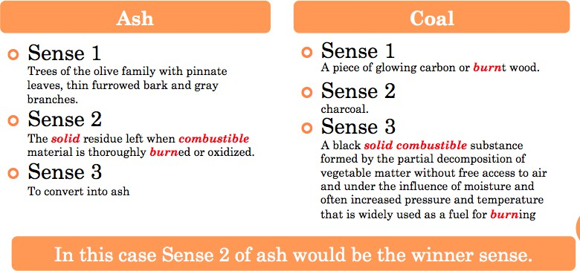
Lesk’s Algorithm
Sense Bag: contains the words in the definition of a candidate sense of the ambiguous word.
Context Bag: contains the words in the definition of each sense of each context word.
On burning coal we get ash.
Week 8, Lecture 3
5 / 15

Slide 23
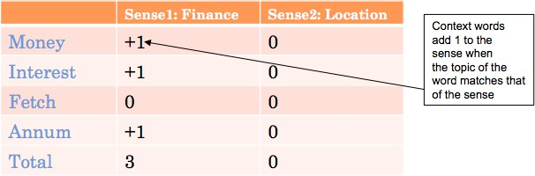
Walker’s Algorithm
A Thesaurus Based approach
Step 1: For each sense of the target word find the thesaurus category to which that sense belongs
Step 2: Calculate the score for each sense by using the context words. A context word will add 1 to the score of the sense if the thesaurus category of the word matches that of the sense.
E.g. The money in this bank fetches an interest of 8% per annum
Target word: bank
Clue words from the context: money, interest, annum, fetch
Week 8, Lecture 3
6 / 15

Slide 24
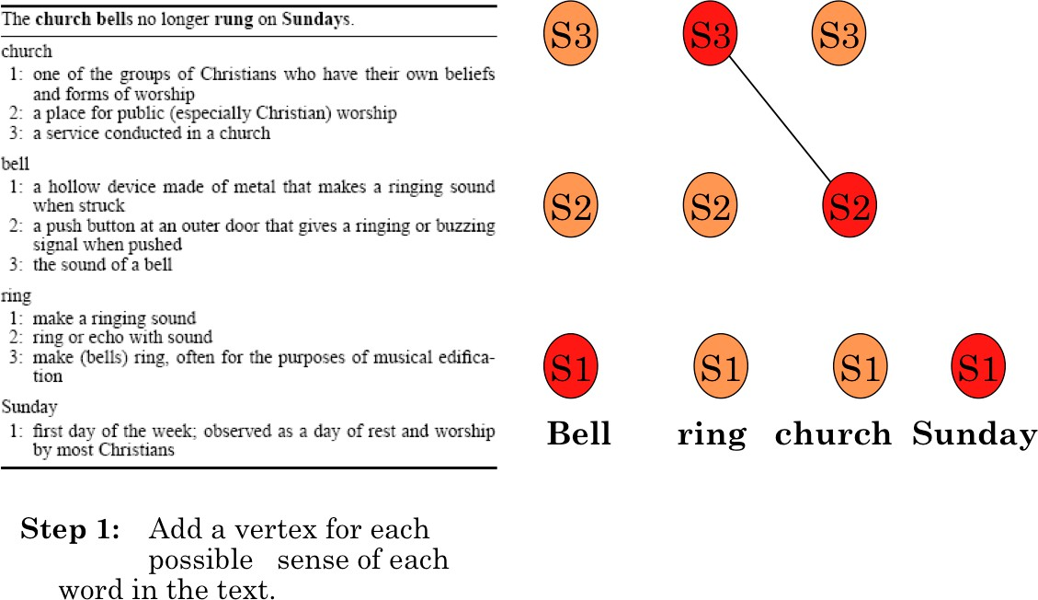
WSD Using Random Walk Algorithm
Week 8, Lecture 3

Slide 25
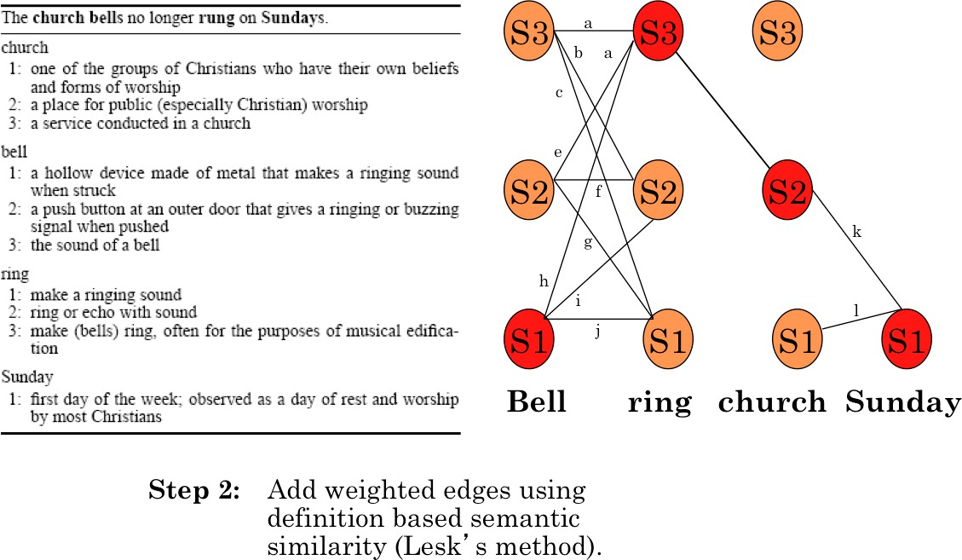
WSD Using Random Walk Algorithm
Week 8, Lecture 3

Slide 26
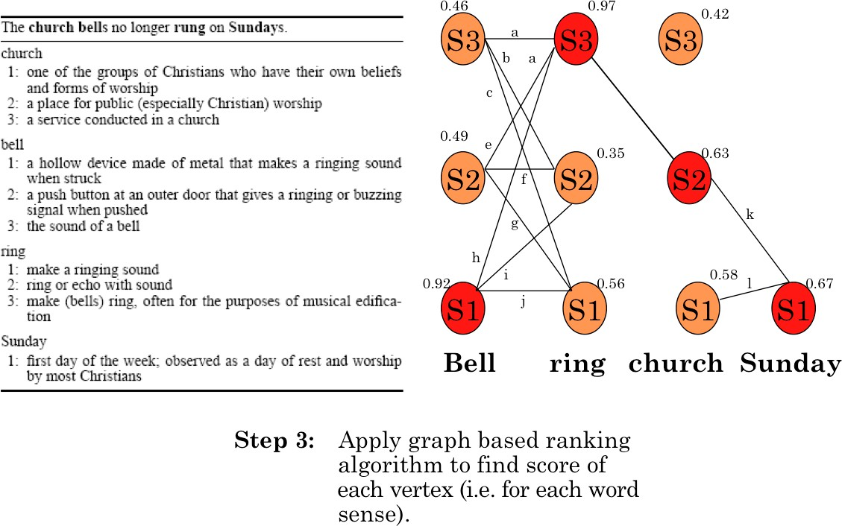
WSD Using Random Walk Algorithm
Week 8, Lecture 3

Slide 27
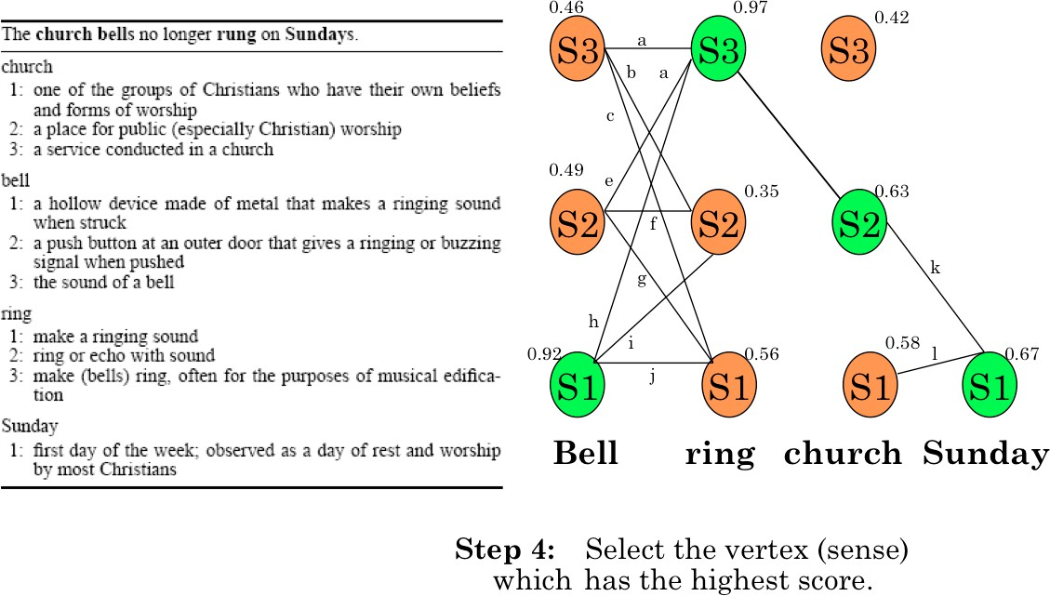
WSD Using Random Walk Algorithm
Week 8, Lecture 3

Slide 28
Naïve Bayes for WSD
A Naïve Bayes classifier chooses the most likely sense for a word given the features of the context:
ˆs = argmax P(s|f )
s∈S
Using Bayes’ law, this can be expressed as:
P(s)P(f |s)
ˆs = argmax
s∈S
P(f )
= argmax P(s)P(f |s)
s∈S
The ‘Naïve’ assumption: all the features are conditionally independent, given the sense’:
n
.
ˆs = argmax P(s) P
j=1
(f |s)
j
s∈S
Week 8, Lecture 3
11 / 15

Slide 29
Training for Naïve Bayes
‘f ’ is a feature vector consisting of:
POS of w
Semantic and Syntactic features of w
Collocation vector (set of words around it) → next word (+1), +2, -1, -2 and their POS’s
Co-occurrence vector
Set parameters of Naïve Bayes using maximum likelihood estimation (MLE) from training data
count(s_{i}, w_{j})
P(s ) =
i
count(w_{j})
count(f_{j}, s_{i})
P(f |s ) =
j i
count(s_{i})
Week 8, Lecture 3
12 / 15

Slide 30
Word Sense Disambiguation - II
Week 8, Lecture 4

Slide 31
Minimally Supervised WSD - Yarowsky
Annotations are expensive! “Bootstrapping” or co-training
Start with (small) seed, learn decision list
Use decision list to label rest of corpus
Retain ‘confident’ labels, treat as annotated data to learn new decision list
Repeat . . .
Heuristics (derived from observation):
One sense per discourse
One sense per collocation
Week 8, Lecture 4
2 / 14

Slide 32
More about heuristics
One Sense per Discourse
A word tends to preserve its meaning across all its occurrences in a given discourse
One Sense per Collocation
A word tends to preserve its meaning when used in the same collocation
Strong for adjacent collocations
Weaker as the distance between the words increases
Week 8, Lecture 4
3 / 14

Slide 33
Yarowsky’s Method
Example
Disambiguating plant (industrial sense) vs. plant (living thing sense) Think of seed features for each sense
Industrial sense: co-occurring with ‘manufacturing’
Living thing sense: co-occurring with ‘life’
Use ‘one sense per collocation’ to build initial decision list classifier
Treat results (having high probability) as annotated data, train new decision list classifier, iterate
Week 8, Lecture 4

Slide 34
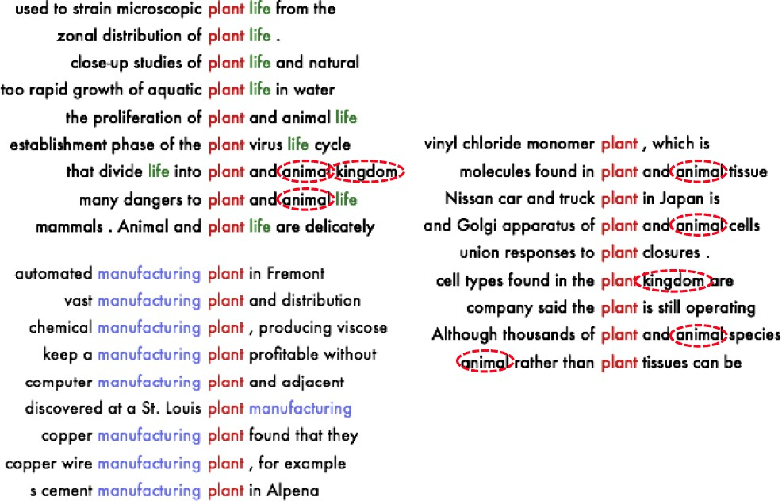
Yarowsky’s Method: Example
Week 8, Lecture 4

Slide 35
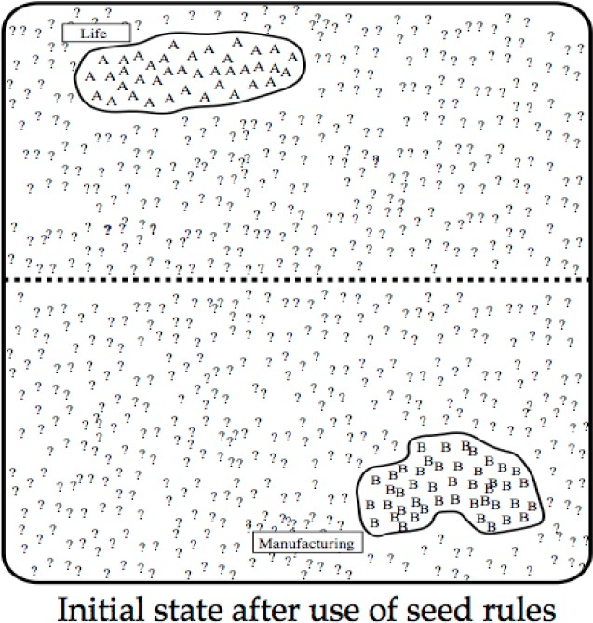
Yarowsky’s Method: Example
Word Sense Disambiguation - II
Week 8, Lecture 4

Slide 36
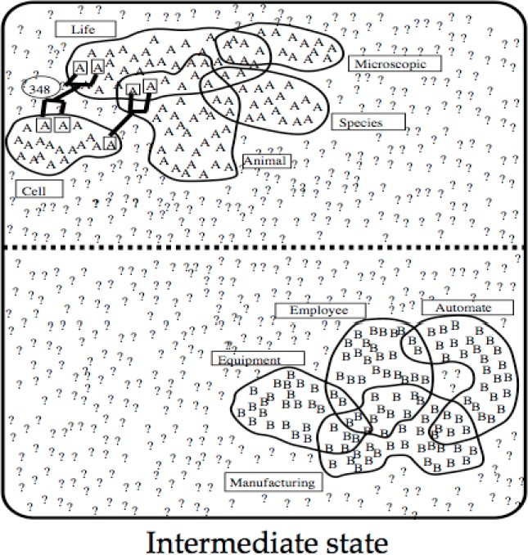
Yarowsky’s Method: Example
Week 8, Lecture 4

Slide 37
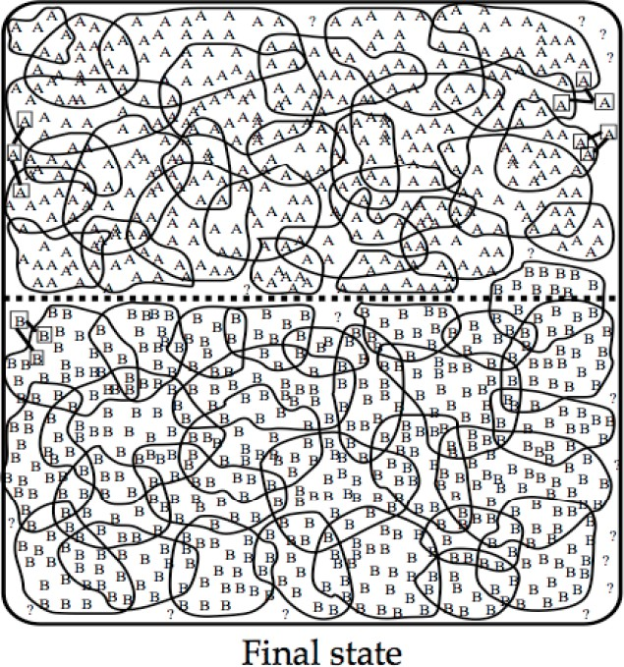
Yarowsky’s Method: Example
Week 8, Lecture 4

Slide 38
Yarowsky’s Method
Termination
Stop when
Error on training data is less than a threshold
No more training data is covered
Use final decision list for WSD
Advantages
Accuracy is about as good as a supervised algorithm Bootstrapping: far less manual effort
Week 8, Lecture 4

Slide 39
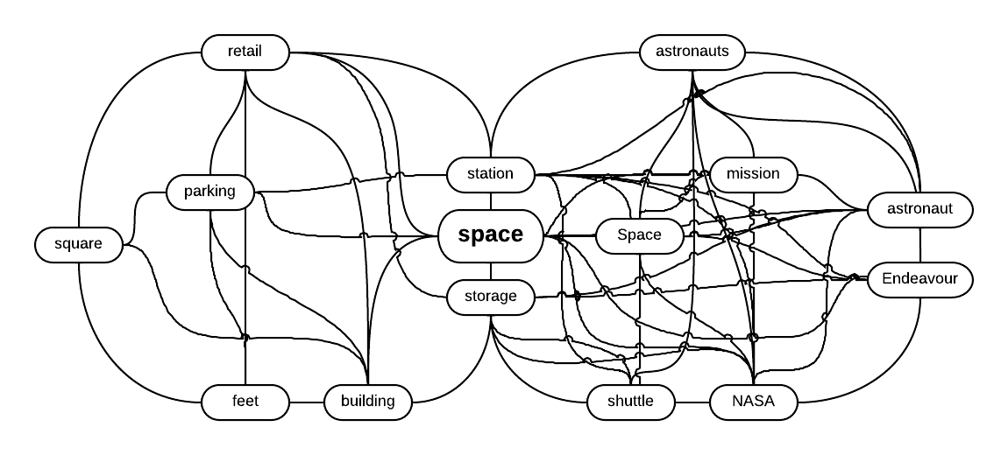
HyperLex
Key Idea: Word Sense Induction
Instead of using “dictionary defined senses”, extract the “senses from the corpus” itself
These “corpus senses” or “uses” correspond to clusters of similar contexts for a word.
Week 8, Lecture 4
10 / 14

Slide 40
HyperLex
Detecting Root Hubs
Different uses of a target word form highly interconnected bundles (or high density components)
In each high density component one of the nodes (hub) has a higher degree than the others.
Step 1: Construct co-occurrence graph, G.
Step 2: Arrange nodes in G in decreasing order of degree.
Step 3: Select the node from G which has the highest degree. This node will be the hub of the first high density component.
Step 4: Delete this hub and all its neighbors from G.
Step 5: Repeat Step 3 and 4 to detect the hubs of other high density components
Week 8, Lecture 4
11 / 14

Slide 41
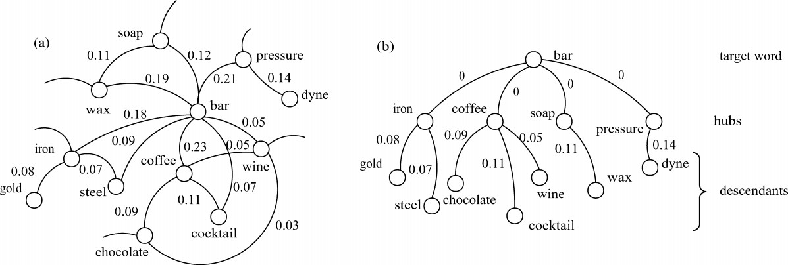
HyperLex: Detecting Root Hubs
Week 8, Lecture 4

Slide 42
Delineating Components
Attach each node to the root hub closest to it.
The distance between two nodes is measured as the smallest sum of weights of the edges on the paths linking them.
Computing distance between two nodes w_{i} and w_{j}
w_{ij} = 1 − max{P(w_{i}|w_{j}), P(w_{j}|w_{i})}
where P(w_{i}|w_{j}) = ^{freqij}
freqj
Week 8, Lecture 4
13 / 14

Slide 43
Disambiguation
Let W = (w₁, w₂,..., w_{i}, . . . , w_{n}) be a context in which w_{i} is an instance of our target word.
Let w_{i} has k hubs in its minimum spanning tree
A score vector s is associated with each w_{j} ∈ W(j ≠ i), such that s_{k} represents the contribution of the kth hub as:
s_{k} = ¹ if h_{k} is an ancestor of w_{j}
s_{i}
1 + d(h_{k}, w_{j})
= 0 otherwise.
All score vectors associated with all w_{j} ∈ W(j ≠ i) are summed up The hub which receives the maximum score is chosen as the most appropriate sense
Week 8, Lecture 4
14 / 14

Slide 44
Novel Word Sense Detection
Week 8, Lecture 5

Slide 45
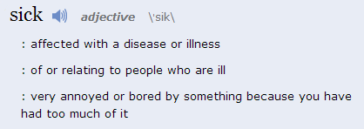
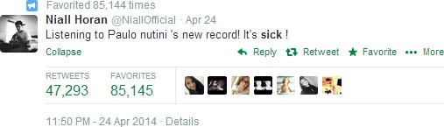
Tracking Sense Changes
Classical sense
1
Novel sense
¹http://www.merriam-webster.com/
Week 8, Lecture 5
2 / 5

Slide 46
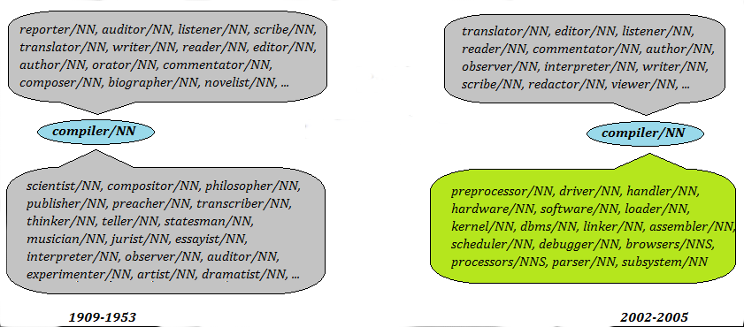
Comparing sense clusters
If a word undergoes sense change, this can be detected by comparing the sense clusters obtained from two different time periods
Week 8, Lecture 5
3 / 5

Slide 47
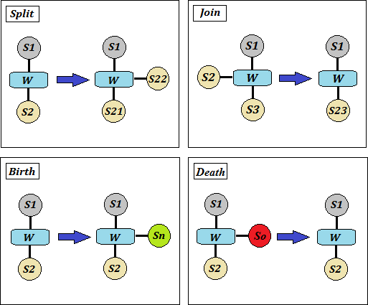
Split, join, birth and death
Week 8, Lecture 5

Slide 48
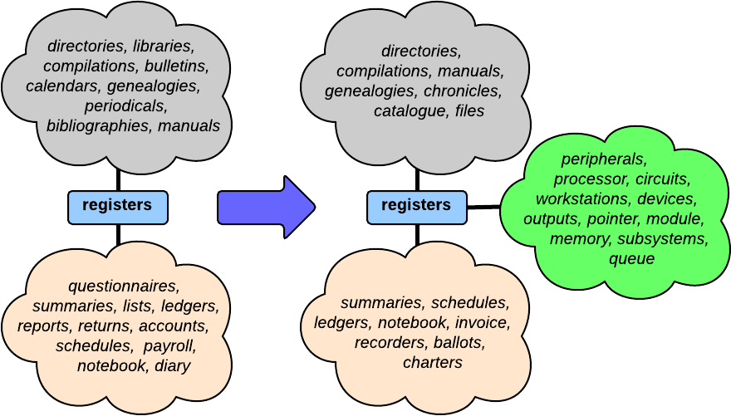
A real example of birth
Week 8, Lecture 5

